Slide 1
Molecular Biology Biol 480
Lecture 24 March 25th, 2019

Slide 2
Announcements/Assignments
Hand in lab notebooks
Handout---lab for this week (problems uploading to our website)
Out of town Friday/Monday
Exam Monday, April 1—proctored by ____________
Presentation topics—general comments

Slide 3
Where were we? Translation
Ribosomes---composition/function
rRNA , proteins
tRNA---transcribed from genes, then charged with amino acids. Mechanism
Mechanism of translation—review animation

Slide 4
Translation is a universal mechanism in biology. So it is not surprising that the biomolecules involved are strikingly similar in all organisms (biologically conserved).

Slide 5
16S rRNA
Yeast
E. coli

Slide 6
We also discussed how some parts of rRNA are not conserved and actually make a good sequence to analyze to see if 2 closely related organisms are actually different.
http://microbe.net/simple-guides/fact-sheet-rrna-in-evolutionary-studies-and-environmental-sampling/
http://www.ncbi.nlm.nih.gov/pmc/articles/PMC2045242/

Slide 7
rRNA based Phylogenetic tree

Slide 8
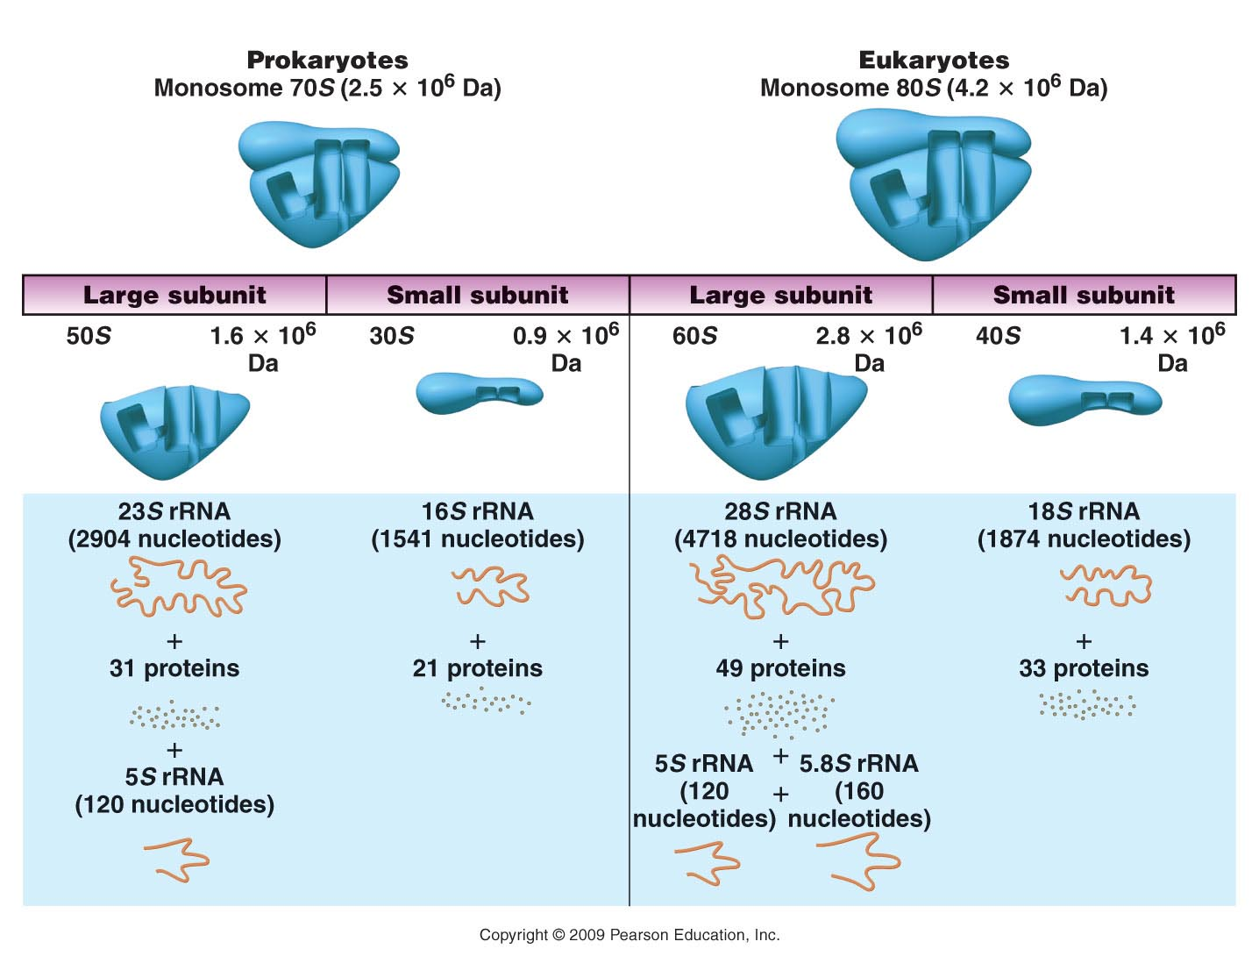
Figure 15.1
Notes:
Figure 15-1 A comparison of the components in the prokaryotic and eukaryotic ribosome.

Slide 9
Translation initiation
Let’s return to an important concept---mRNAs in both prokaryotes and in eukaryotes are longer than needed to encode the protein they make.
Each end has some untranslated region.
5’UTR
3’UTR

Slide 10
We have a good understanding of how the ribosome knows it has reached the 3’ end. (Stop codons have no corresponding charged tRNAs that bind them)
But what about the start codon? How does the ribosome know to start at AUG? …especially when AUG may be found at several places in the mRNA code.

Slide 11
A common theme…
Specific sequence in the mRNA usually lies just upstream of the start AUG.
In bacteria/archaea we call this sequence the Shine-Delgarno sequence,
In Eukaryotes we call the sequence the Kozak sequence.

Slide 12
The sequence lies ~8 nucleotides upstream (5’) of the start AUG. There is a consensus sequence in prokaryotes (AGGAGG).
In E. coli, for example, the sequence is AGGAGGU.

Slide 13
How does a ribosome find a Shine-Delgarno sequence?
Any guesses?

Slide 14
How does a ribosome find a Shine-Delgarno sequence?
Any guesses?
The complementary sequence (CCUCCU), is called the anti-Shine-Dalgarno sequence and is located at the 3' end of the 16S rRNA in the ribosome.

Slide 15
The complementary sequence (CCUCCU), is called the anti-Shine-Dalgarno sequence and is located at the 3' end of the 16S rRNA in the ribosome.

Slide 17
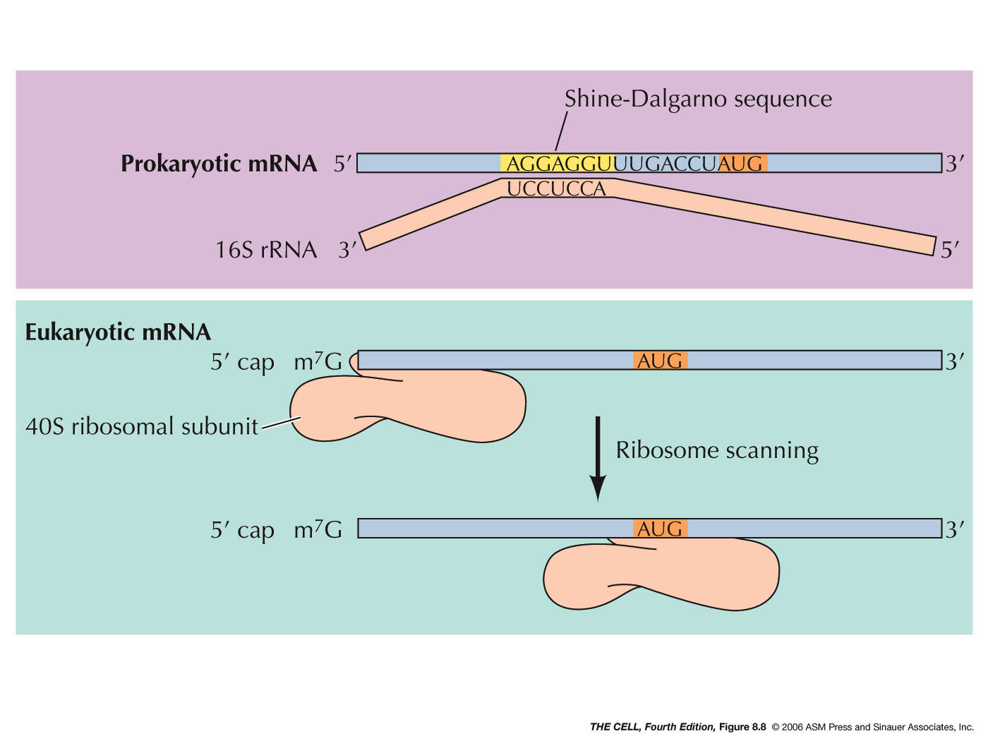
Eukaryotic mRNAs also use their modified 5’ end to help initiate translation.

Slide 18
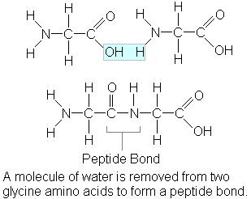
We’ve only brushed the topic of connecting amino acids during translation.
The bond created is called a peptide bond.

Slide 19
Which part of the ribosome is responsible for this chemical bond formation.
Any guesses? It’s the RNA component! The 23S rRNA has been shown to have the catalytic activity in peptide bond formation.

Slide 20
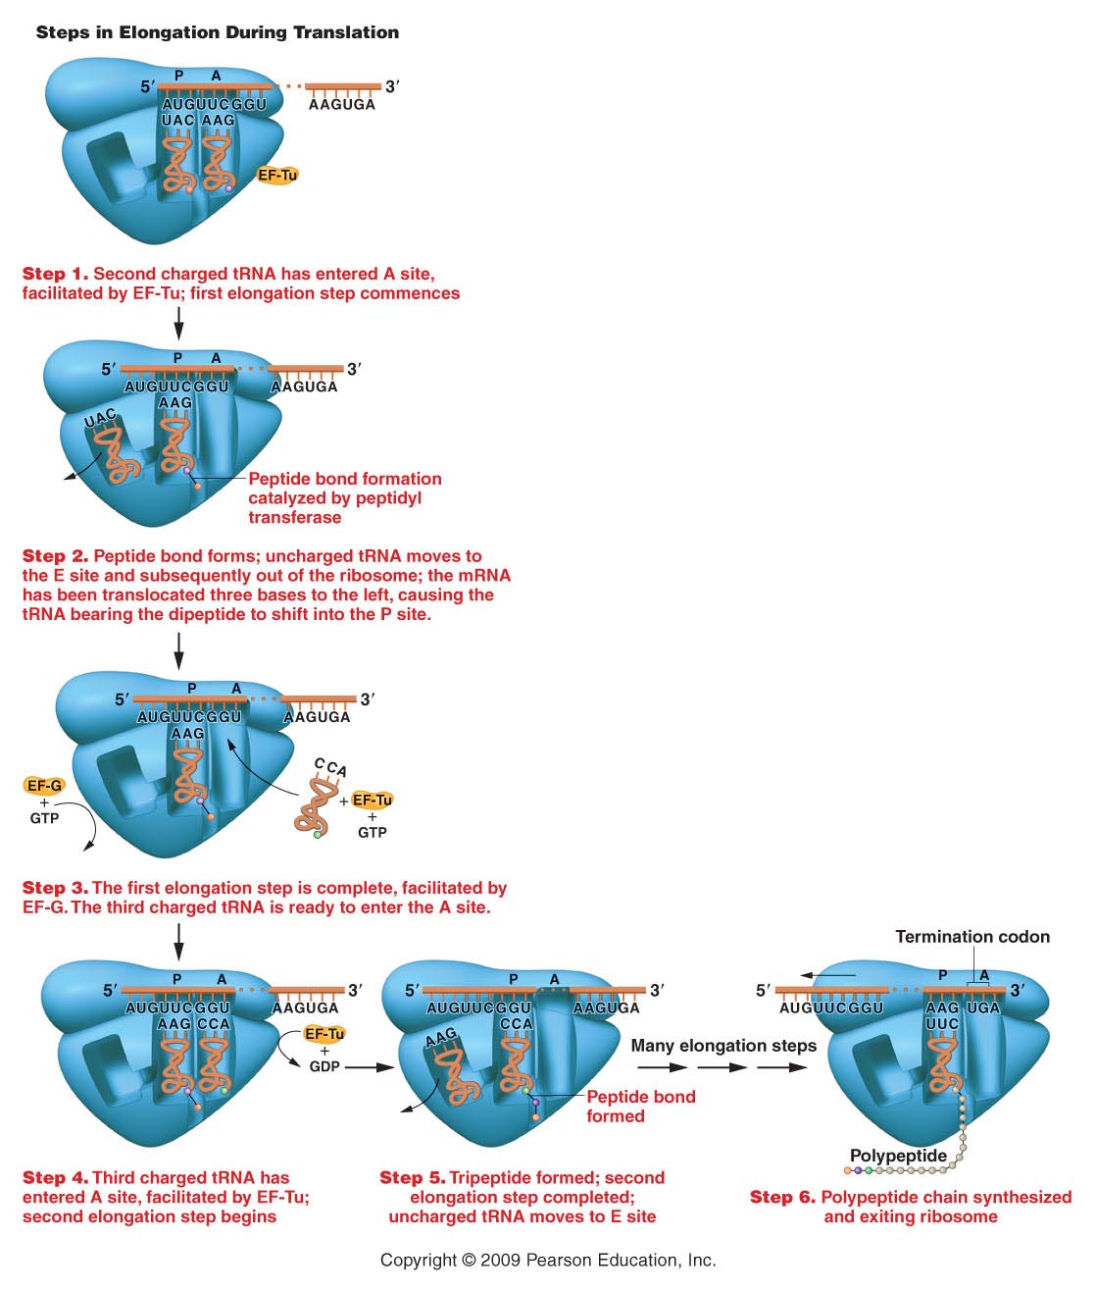
Figure 15.7
Notes:
Figure 15-7 Elongation of the growing polypeptide chain during translation.

Slide 21
A closer look at ribosome compartments

Slide 23
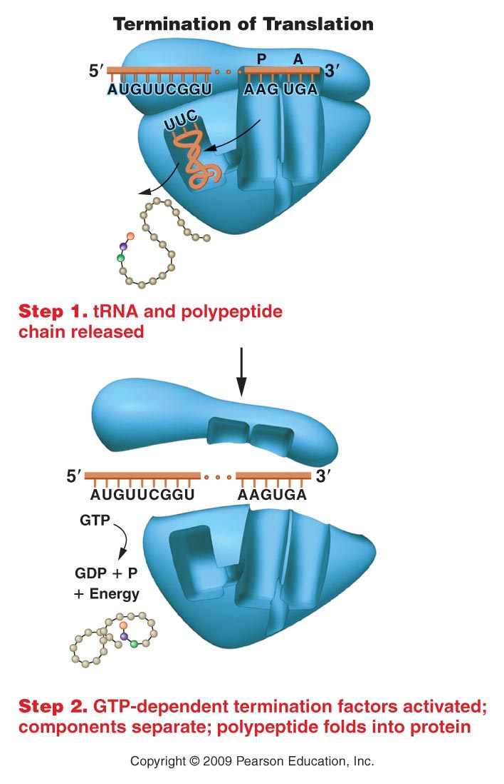
The elongation phase continues until one of the termination/stop codons is positioned in the A site.
Since there are no tRNAs with attached amino acids and an anticodon to match the termination codons, translation stalls at this point.
Figure 15.8
Notes:
Figure 15-8 Termination of the process of translation.

Slide 24
You may have noticed…several steps in translation require energy.
ATP to charge the tRNAs
GTP to activate several of the translation factors.
GTP to release the ribosome from the mRNA
In each case, the ATP/GTP changes the conformation a protein to activate it.

Slide 25
Proteins that bind GTP for activation are known generally as G-proteins. Many cell communication pathways utilize G-proteins.
http://en.wikipedia.org/wiki/G_protein
http://blogs.scientificamerican.com/the-curious-wavefunction/2012/10/10/g-protein-coupled-receptors-gpcrs-win-2012-nobel-prize-in-chemistry/

Slide 26
Where, in the cell does translation take place?
Prokaryotes have have a single compartment for all cellular processes. Translation can occur at the same time as transcription---we will even see how gene expression regulation can utilize aspects of both transcription and translation.
Eukaryotes export processed mRNA from the nucleus for translation.

Slide 27
In eukaryotes proteins are made in 2 places
Cytoplasm
Using so called “free ribosomes”
Endoplasmic reticulum
Using ER-bound ribosomes (“rough ER)

Slide 28
What determines translation location?
In part the protein does! Proteins that are destined for packaging into vesicles and/or export from the cell need to go through the membrane network of ER and golgi.
Translation is initiated and the first (N-terminal) amino acid sequence can redirect the protein to the ER.

Slide 29
https://en.wikipedia.org/wiki/Signal_peptide
The first few amino acids (16-30) are recognized by a RNA/protein complex known as the signal recognition particle (SRP) which directs the partially translated mRNA to the ER.
https://en.wikipedia.org/wiki/Signal_recognition_particle

Slide 31
Some ER-bound proteins
Protein | Amino Acid Sequence*
Preproalbumin | Met-Lys-Trp-Val-Thr-Phe-Leu-Leu-Leu-Leu-Phe-Ile-Ser-Gly-Ser-Ala-Phe-Ser ↓ Arg . . .
Pre-IgG light chain | Met-Asp-Met-Arg-Ala-Pro-Ala-Gln-Ile-Phe-Gly-Phe-Leu-Leu-Leu-Leu-Phe-Pro-Gly- Thr-Arg-Cys ↓ Asp . . .
Prelysozyme | Met-Arg-Ser-Leu-Leu-Ile-Leu-Val-Leu-Cys-Phe-Leu-Pro-Leu-Ala-Ala-Leu-Gly ↓ Lys . . .
This ER signal sequence is usually cleaved off of the mature protein after it directs the newly synthesized protein to complete translation in ER.

Slide 32
Post-Translational Modifications
N-terminus amino acid is often removed or modified. Very few proteins actually have methionine at the N-terminus.

Slide 33
More posttranslational modifications
Individual amino acids are often modified
Carbohydrate side chains are often added
phosphate groups may be added
Lipids may be added
Polypeptide chains may be trimmed
Signal sequences are removed
Polypeptides are often complexed with metals

Slide 35
Let’s not lose sight of how protein folding affects protein function…
Protein structure DETERMINES what the protein does. Failure to fold correctly or to be properly modified, mean the protein does not work.

Slide 36
For example, enzymes which don’t fold properly will likely have modified active site shape and will not bind properly to their substrate(s).
If the enzyme is essential to the cell’s function, the cell will likely die. At the very least, the cell will be useless to the organism.

Slide 37
In some cases, misfolded proteins are more than useless—they can be dangerous.
Neurodegenerative diseases like Alzheimer and, mad cow and Creutzfeldt-Jakob disease (the human version of mad cow disease) are the result of misfolded proteins that actually damage normal tissue.

Slide 38
These proteins, known as prions---coax other molecules of the same protein to misfold.
There is no amino acid sequence difference between the normal protein and the misfolded version.

Slide 39
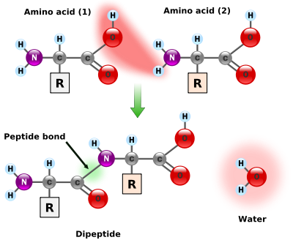
Let’s look at amino acid structure again. All amino acids have a common backbone structure.

Slide 40
Each of the 20 amino acids has a unique side chain/R-group.

Slide 41
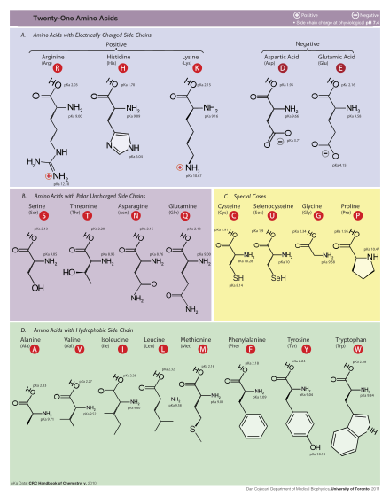

Slide 42
The chemical reactions/bonds made in proteins are the result of:
Interactions of atoms in every amino acid (backbone interactions)
Interactions of atoms in specific R groups.

Slide 43
Protein folding is the result of interactions, primarily noncovalent interactions, between amino acids that are not linked by peptide bonds. (not adjacent amino acids)
Protein folding is defined in 4 levels.

Slide 44
Protein structure
Primary structure is simply the amino acid sequence of a protein. (Thus technically not an aspect of folded structure)
Primary structure, determines everything about the final, folded structure of the protein.

Slide 45
Secondary structure
Only 2 forms of secondary structure:
α helix
β sheet
Both form with certain primary structure using H-bonds involving atoms of the amino groups and carboxy groups. (R-groups are not involved)
Figure 15-18

